Slide 1



__Machine Learning__ __Computer Vision___
Presented By :
AMNA SHAKEEL
Comsats University Islamabad

Slide 2

Credit Card Fraud Detection

Slide 3


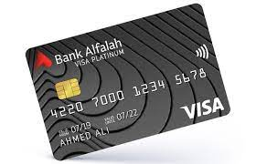
Outline
Introduction
Classification
Data Modeling
Algorithms
Evaluation

Slide 4
What Is Credit Card Fraud?
Credit card fraud is when someone uses another person's credit card or account information to make unauthorized purchases or access funds through cash advances. Credit card fraud doesn’t just happen online; it happens in brick-and-mortar stores, too.
We live in a world where cash transactions are quickly being replaced by credit card transactions.
person will not pay for the item he did not purchase.

Slide 5
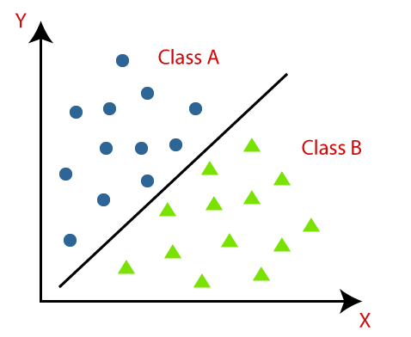
Classification
The Classification algorithm is a Supervised Learning technique that is used to identify the category of new observations on the basis of training data.
Binary Classification
If the classification problem has only two possible outcomes, then it is called as Binary Classifier.
0-1, Yes-No, positive-negative, True-False, Pass-Fail, Alive-Dead.
Fraud/Non Fraud.

Slide 6
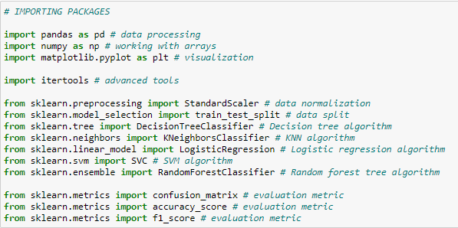
Steps Involved
Importing the required packages into our python environment.

Slide 7
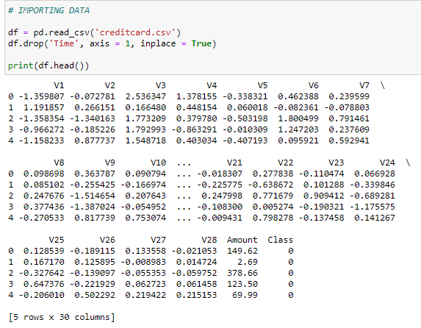
Importing the data

Slide 8
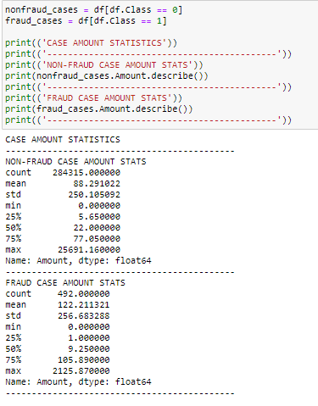
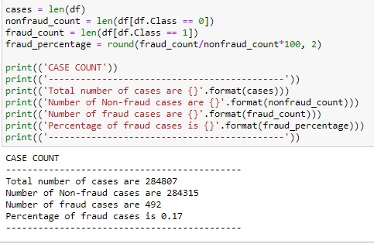
Processing the data to our needs and Exploratory Data Analysis
Data Processing and EDA

Slide 9
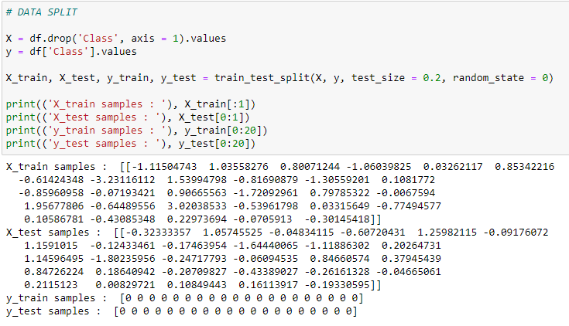
Feature Selection and Data Split

Slide 10
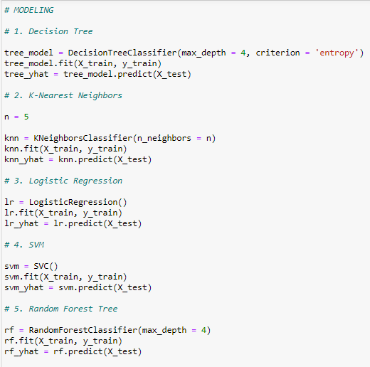
Building 5 types of classification models
Decision Tree
K-Nearest Neighbors (KNN)
Logistic Regression
Support Vector Machine (SVM)
Random Forest

Slide 11
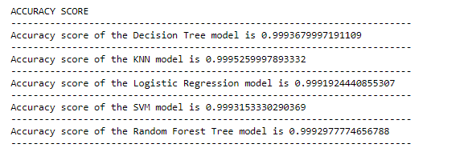
Evaluating the created classification models using the evaluation metrics
Accuracy score
Accuracy score = No of correct predictions / Total no. of predictions

Slide 12
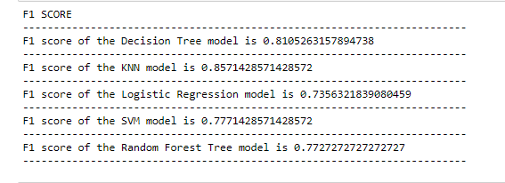
F1 Score
F1 score = 2( (precision * recall) / (precision + recall) )

Slide 13
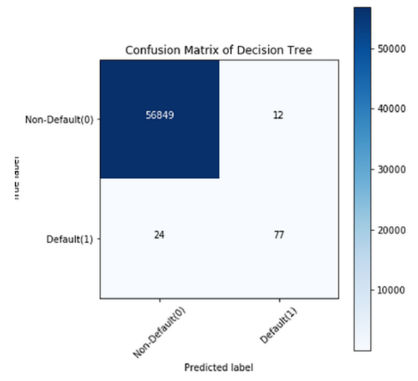
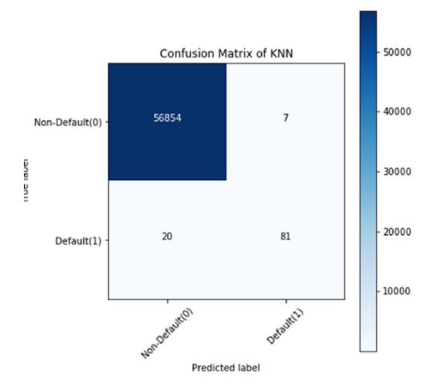
Confusion Matrix

Slide 14
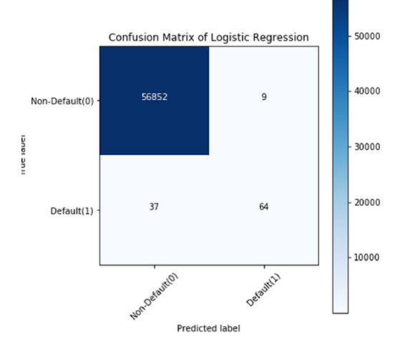
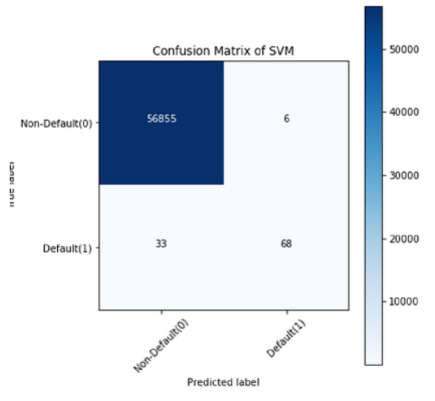
Confusion Matrix

Slide 15
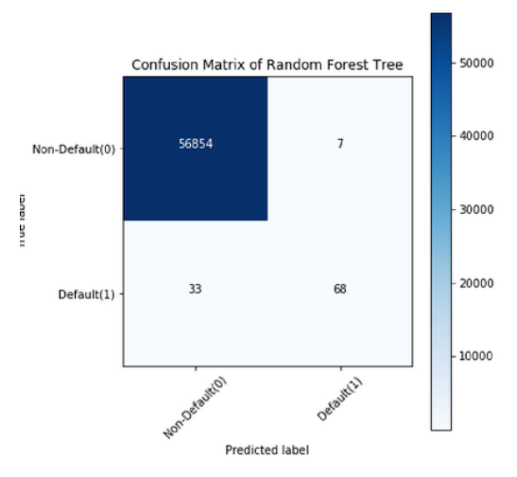
Confusion Matrix

Slide 16


